Slide 1
Technology ignites our business Make Tomorrow Together
Notes:
Welcome everyone, my name is xxxxxxxxxxxxxxx and I’m a xxxxxxxxxxxxxx a JPMorgan Chase. Thank you for joining me today! I’m going to spend the next xx minutes talking you through the world of Technology at JPMorgan Chase. We’re not just a financial institution, we’re one of the world’s biggest technology driven companies.
Technology is hard wired into everything we do. In fact, in many of our businesses, Technology is our product. We sell technology solutions to clients and we have some incredible talent across our 14 global technology hubs and additional strategic locations around the world who help us to do that. We’re looking for the best technologists to join us and become our future leaders. Later on in this presentation I’ll explain exactly how you start your career with us.
Key points to cover:
Meaningful work
Collaboration
Career development

Slide 2
We invest over $10 billion in technology each year
Your career here will be limited only by your own ambition
Notes:
We invest over $10 billion in technology each year, of which approximately $3 billion is dedicated toward new initiatives. That rivals some of the biggest names in Tech!
In 2016 we spent $600 million on emerging fintech solutions – which included building and improving digital and mobile services and partnering with fintech companies – but more on that later.
The reasons we invest so much in technology (whether it’s digital, big data, or machine learning) are simple: to benefit customers with better, faster and often cheaper products and services and make the firm more efficient. We use almost every type of digital technology to solve some of the world’s most complex tech problems, which means that if you join us you’ll be given the chance to problem solve and create new opportunities that could have an impact on clients, customers and employees around the world, while we help you to develop and progress your career.
It’s fair to say that here, you’ll have a career that has no limits other than your own ambition.
Key points to cover:
Meaningful work
Collaboration
Career development

Slide 3
80% of Fortune 500 companies do business with us
Leading our industry means constant reinvention and innovation
Joining us will help you build the skills to deliver creative solutions from the start

Slide 4
50,000 technologists
Our global team creates the solutions that will fuel our firm's future – and yours
Notes:
Our technology helps everyone from consumers to multinational corporate clients, sovereign wealth funds and those making multibillion dollar cross border payments. We build some of the largest, most highly used consumer banking and professional interfaces. Did you know that those interfaces are used by 50% of households in the US? Or that our Investment Bank securely processes $5 trillion in payments every day? Or that our Treasury Services business supports approximately 80% of the global Fortune 500?
Leading our industry means constant reinvention and innovation. Advances in technology make us faster and safer and drive a more engaging experience for our customers. And as the pace of technology is always increasing we constantly challenge ourselves to do better!
We look for fresh perspectives to give us our technological edge and we reinforce a strong culture of innovation to spark new solutions through open source projects and hackathons in which technologists collaboratively code to solve problems.
The scale and diversity of our businesses enables us to invest wherever we see opportunity or a competitive advantage and we’ll continue to grow the amount that we invest in new technology and innovation by optimizing our existing technology environment, maintaining a relentless focus on cybersecurity to protect the firm and enabling the secure introduction of new capabilities. So if you’re a passionate about having a career in Technology with global impact this is a great place to be. We’ll offer you hands-on experience to help you deliver creative solutions from the start.
Key points to cover:
We build some of the largest, most highly used consumer banking and professional interfaces. You’ll get to work on projects that can drive a more engaging experience for our clients and customers worldwide.
We’re looking for fresh perspectives from tech talent like you to help us constantly improve and do better for our clients
If you’re looking for a career in Technology with global impact this is the place to be

Slide 5
Glasgow
London
Jersey City
Bournemouth
Chicago
New York
Dallas
Columbus
Brooklyn
Houston
Delaware
Herzliya
Tampa
Hong Kong
Mumbai
Hyderabad
Bengaluru
Singapore
Opportunities
Buenos Aires
around the globe
Notes:
We have our Global Technology hubs and strategic technology locations around the world – and while they may be far apart geographically, they are all part of one unified team!
We based our Global Technology hubs and strategic technology locations in these locations based on their access to top technology talent, their proximity to our businesses and our ability to offer employees robust career development opportunities.
Key points to cover:
You’ll be part of a global community – we have Global Technology hubs and strategic technology locations around the world but we’re one team!
This offers you the chance to grow your network and have diverse experiences that can help you to develop your career

Slide 6
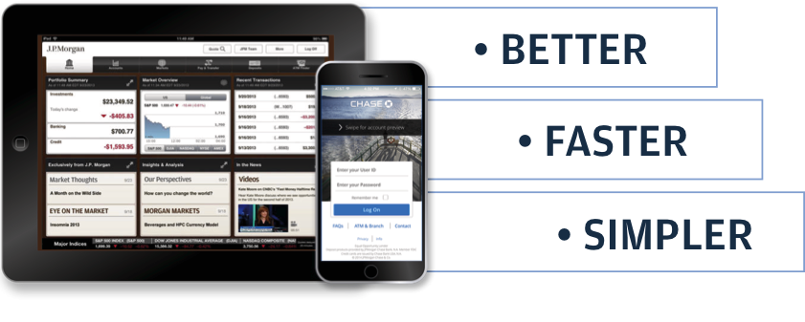
Our technologists help make banking experiences for customers and institutional clients….
BETTER
FASTER
SIMPLER
Notes:
So, hopefully at this stage it’s clear that our technologists help make banking experiences better, faster and simpler for our customers and clients worldwide.

Slide 7

Collaborative environments
High-performance workplaces promote productivity,
Collaboration, choice and flexibility
Notes:
And, to help you do that you’ll work in a progressive environment that lets you use your own devices to seamlessly work from anywhere in the world.
We are moving towards having high performance workspaces across our 14 Global Technology Hubs and additional strategic locations. You’ll be able to connect with colleagues via advanced video-conferencing facilities and work in state-of-the-art workspaces that foster teamwork, collaboration and innovation.
Key points to cover:
We foster effective collaboration through our working environment as well as how we work with each other
We are working on having high performance workspaces across all of our Tech hubs.

Slide 8
Collaborating with Emerging Technology & FinTech…
AppDynamics
BlackDuck
Cloudera
Forescout
Ondeck
Menlo Security
Sprinklr
Tanium
Truecar
Turbonomic
As well as investing strategically with select partners…
Axoni  Digital Asset Holdings  Investcloud  LevelUp  Symphony
Notes:
I mentioned earlier that last year we spent $600 million on emerging FinTech solutions and I’m going to come back to that now! Emerging technology is changing the way that we do business. Whether it’s auto finance (TrueCar), small business lending (OnDeck Capital) or communications systems (Symphony), we are successfully collaborating with some excellent fintech companies to dramatically improve our digital and other customer offerings that will truly differentiate us as a firm.
Our In-Residence program is a platform that helps us to partner with FinTech companies. The idea is to push the limits of wholesale banking by connecting entrepreneurs with our knowledge, data, space and more in order to solve complex challenges. In-Residence builds partnership with the best and the brightest to co-create solutions that have value not just to us as a firm but also to the financial industry as a whole.
Key Point to Cover:
We spend $600m of emerging FinTech solutions and are successfully collaborating with FinTech companies to improve our digital products and services and solve complex challenges.
*Here’s a sample list for your reference if you are asked who these companies are:

Slide 9
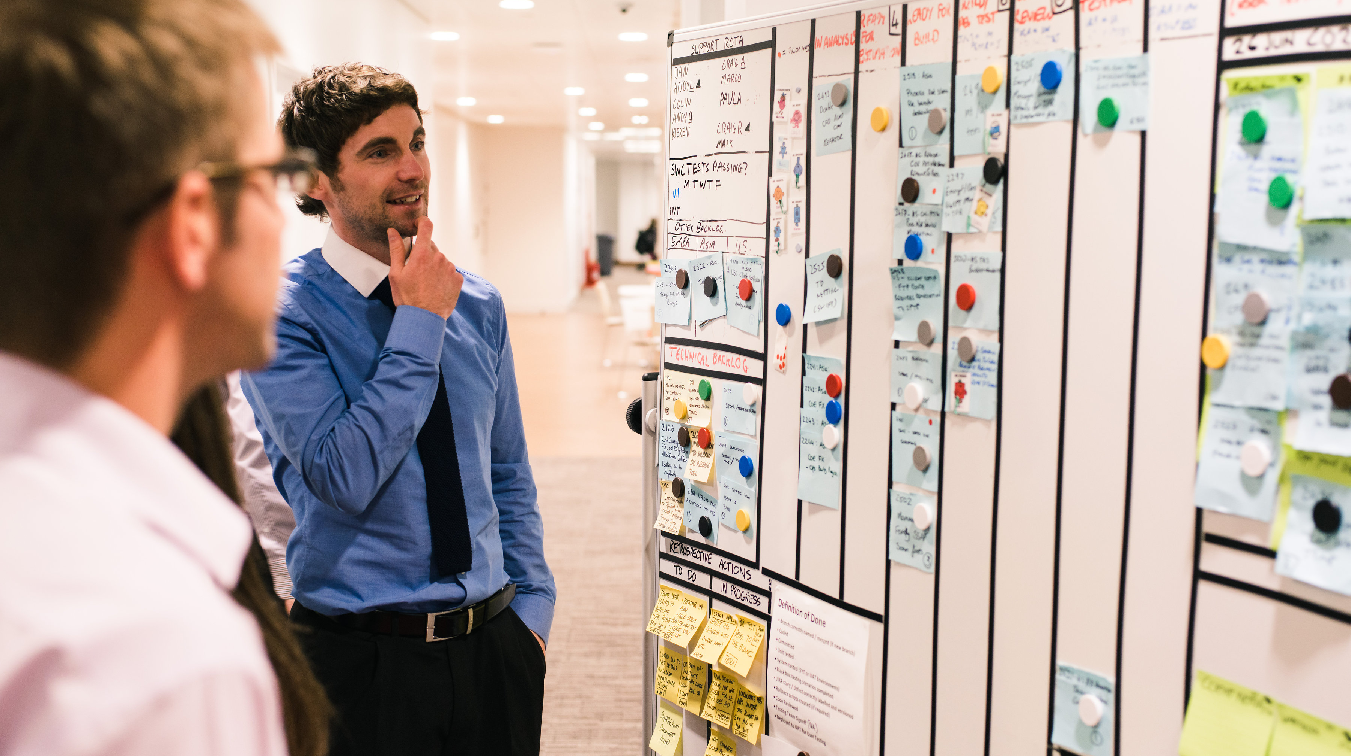
Software engineers
Turn business needs into solutions from ideas to implementation
Notes:
Software Engineers turn business needs into solutions from ideas to implementation. So as a Software Engineer with us, you will:
develop innovative solutions that empower our clients’ businesses and customers’ lives.
join a team of technologists dedicated to improving the design, analytics, development, coding, testing and application programming that goes into creating high-quality software and new products.
update teams and key stakeholders on the progress of what’s being developed.
work with and share ideas, information and innovation with our global team of technologists from all over the world.

Slide 10
Growth & mobility throughout your career
Technology is constantly developing – and so do our people:
Build skills to deliver creative solutions right away
Tailored professional development
Constant reinvention an innovation
Business-wide mobility opportunities
You’ll keep being challenged an never stop learning
Software Engineer Program (Internship)
Code for Good
Software Engineer Program (Full-time)
Full-time Analyst
Tech Connect Program
Notes:
As we all know, Technology is constantly developing, and so do our people.
Our intensive program will help you build skills to deliver creative solutions to our business and our clients in the right way. Our commitment to providing best-in-class industry solutions is enabled by you so in turn, we offer a framework for your career growth through unmatched training, experiences and access across our businesses in over 100 countries.
Your first experience with us could be as part of one of our Code For Good events, which I’ll cover next. You could begin your career with us on our Tech Connect program, which is a session offered to incoming Software Engineers who have technical acumen but need deeper coding experience to enter the Tech workforce with us. This primer then leads onto our intensive induction and then our full time Analyst program.
Alternatively you could join us as a summer intern and then join our full-time program. Or you could join us directly on our full time analyst program!
Key Points to Cover:
We’ll invest in your development by offering unmatched training, experiences and access across our business
We offer a number of different opportunities for you to start your journey with us, from participating in Code For Good to joining Tech Connect, our Internship or Full-Time programs

Slide 11
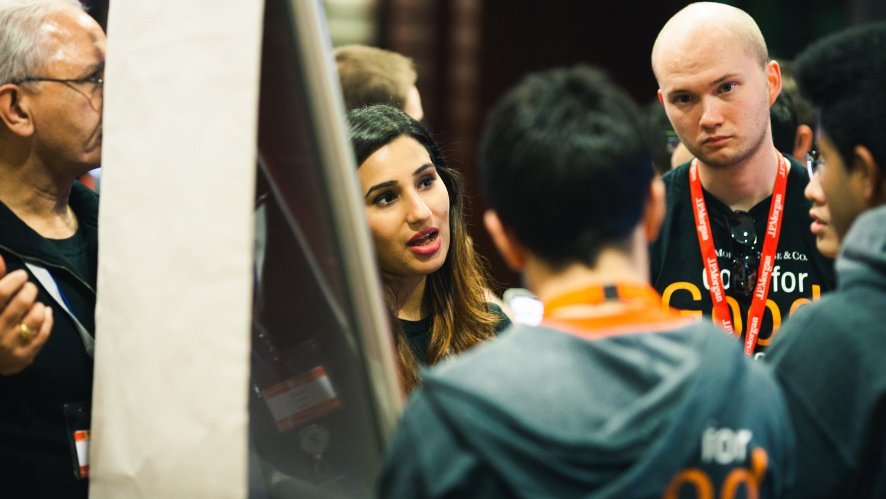
Technology for Social Good
Put your tech talents to work to give back to your community
Notes:
Another great reason to be in Technology here is Technology for Social Good.
Technology for Social Good leverages the power of technology and people to inspire change, foster inclusion, and make a difference in our company and our communities.
Your first opportunity to get involved is Code for Good–a 24-hour coding challenge for university students to showcase their tech skills while helping non-profits solve technology problems.
If you join the firm full-time, you’ll participate in the Force for Good program. Force for Good is a social innovation program that aligns J.P. Morgan technologists into teams working directly with a socially-focused organization to provide technology solutions to real world challenges.
We also run Youth Initiatives that guide students, ages 6-18, through key stages of computer science education including introduction and safety, guidance, and ultimately inspiration to choose a career in technology.
Since Technology for Social Good launched in 2010, 100,000 hours have been contributed to non-profits and 1,500 organizations have been involved.
Key Points to Cover:
Technology for Social Good includes a range of strategic and social good programs that help us to give back to the community and engage top talent.
Major programs include Code for Good, Force for Good and our Youth Initiatives.

Slide 12

Software Engineer Program
Summer Analyst
10-week summer internship
Immersive, hands-on program; learning while doing
Full-time Analyst
2-year development program
Starts with intensive, interactive learning experience with ongoing development
Notes:
As an analyst on our Summer Internship program. You’ll spend your time engineering large scale, complex and resilient technology solutions that drive our global business. You’ll help design, build and implement technology solutions that support millions of customers, clients and employees worldwide, whilst gaining insights into how technology drives the firm’s overall efficiency, improves our risk management and enhances our customer and client experiences.
Our Full-time Analyst program is a two year development program for college graduates interested in launching their career in a dynamic technology organization. The program begins with intensive training delivered by subject matter experts and Tech professionals who work at the firm.
We’re looking for highly motivated, purpose driven individuals with a passion for developing technologies with global impact and these programs offer you a chance to begin carving out your career in our Technology community.
Key Points to Cover:
As a Summer Intern, you’ll spend time engineering large scale, complex and resilient technology solutions that drive our global business and help clients, customers and employees worldwide
Full-time Analysts will start their program with intensive induction training delivered by subject matter experts and Tech professionals

Slide 13
Make Tomorrow Together.
jpmorganchase.com/techcareers
Notes:
So, I hope you’ve learned more about our Technology business and the exciting opportunities that we have to offer. If you are ready to build your career with us, apply via our careers website: jpmorganchase.com/techcareers
You can also connect with us via Twitter, Facebook, LinkedIn, YouTube or Instagram
Thank you!

